Slide 1
Bail Bond Project
Hannah Laper
Venkatesh Rudrappa
Tara Bhardvaj

Slide 2
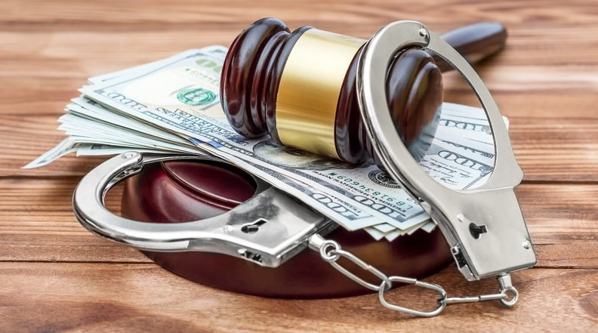
Introduction: What is Bail?
Bail refers to the fee or condition by which someone who has been arrested is allowed to leave jail as they await a trial or hearing. (ABA)
Bail amounts/ conditions reflects the dangerousness of the crime, and the risk to the community. (ABA)

Slide 3
How is it applied?
There is very little formalized guidance for how bail is set, and the logic of these decisions is often hard to parse. (Wired)
It can be hard to determine what factors will result in what bail decision. (The Intercept)

Slide 4

Current state of research: State of Kentucky Risk Matrix models
Kentucky implemented an algorithmic approach to determining risk levels for defendants to guide bail decisions.
This initially let to a 13-percentage point increase in release for defendants deemed low to moderate risk.
There were also systemic issues with the algorithms- some of them increased the risk level for those who are homeless a move that can often have a disproportionate effect on working class people or by proxy race.
Eventually, judges minimized their reliance on the risk assessments and the rate of release went down.

Slide 5

Cash Bail
In many jurisdictions cash bail or the practice of charging a fee to ensure release has been facing scrutiny. (Messenger)
Opponents say it criminalizes the poor while proponents say it incentivizes defendants to return to court. (Messenger)
Fees and fines imposed as a part of cash bond violations can lead to further incarceration and increase recidivism rates. (Messenger)

Slide 6
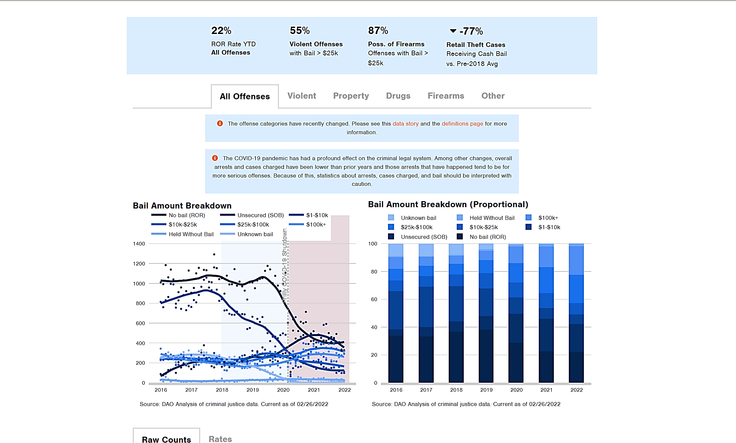
Philly Bail Project
https://data.philadao.com/Bail_Report.html

Slide 7

Research questions
Can we predict whether or not bail will be set?
Can we predict the bail amount?
Can we predict the release conditions?
What factors are the most closely related to the bail decisions being made?
Do we observe any biases in how bail is determined?

Slide 8
Dataset
NYC Pretrial Release data
Source: NY Courts. Gov
https://ww2.nycourts.gov/pretrial-release-data-33136
Shape: (284096, 108)
Date Range: 1/1/2020 – 6/30/2021
Fields: Race, Arrest id, Age at Crime, Gender, Bail made Indicator, Disposition

Slide 9
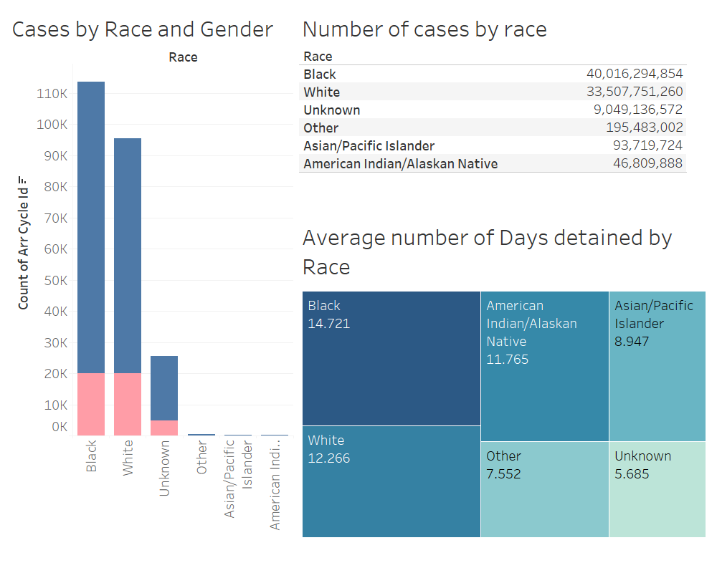
Visualizations

Slide 10
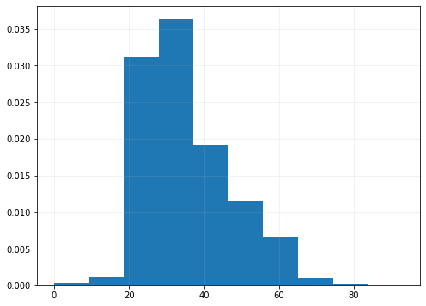
Age at crime

Slide 11
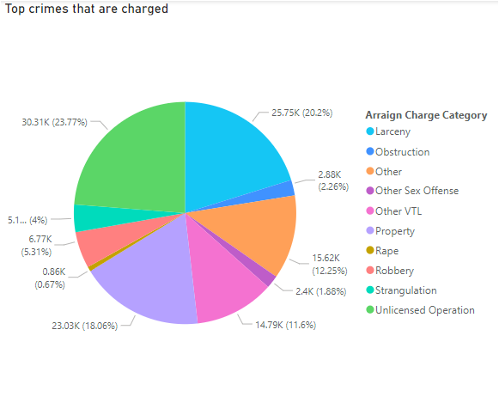
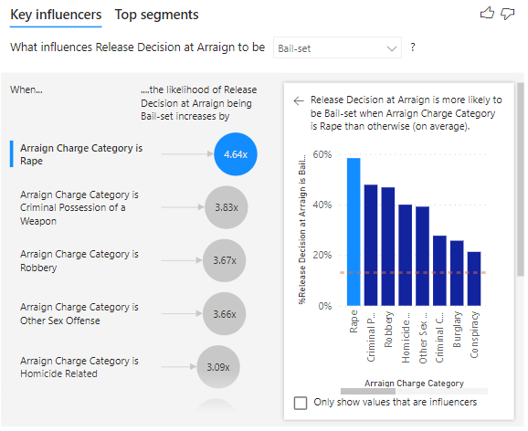

Slide 12
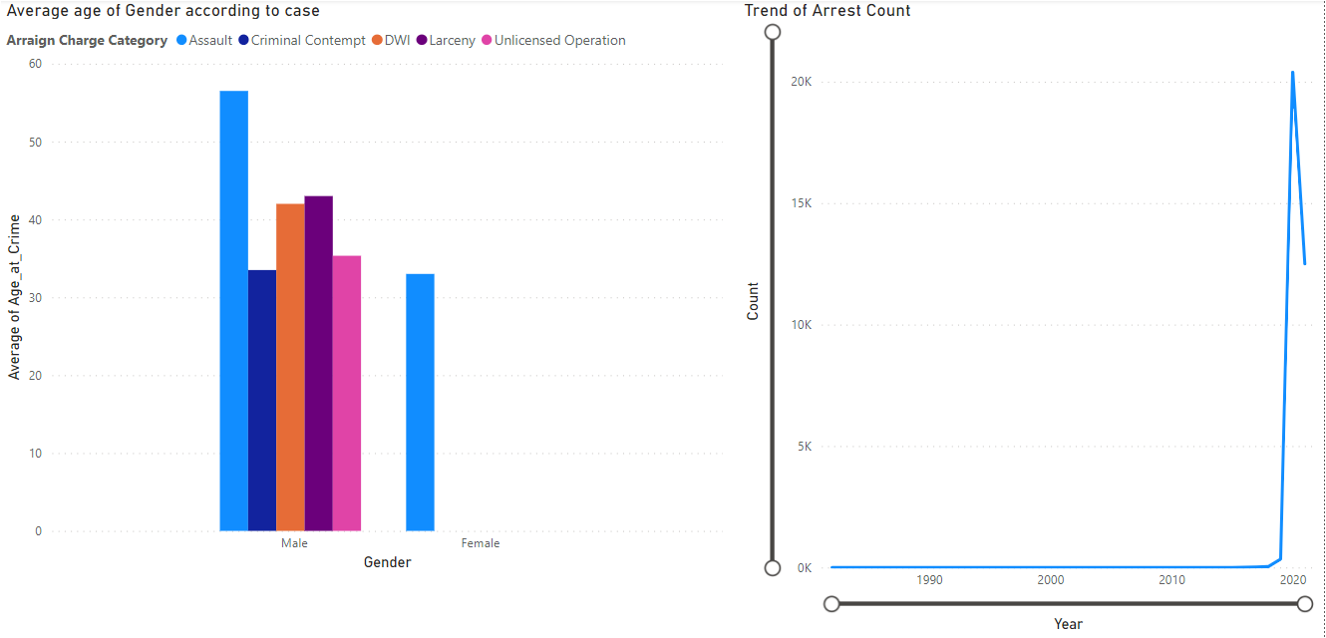

Slide 13
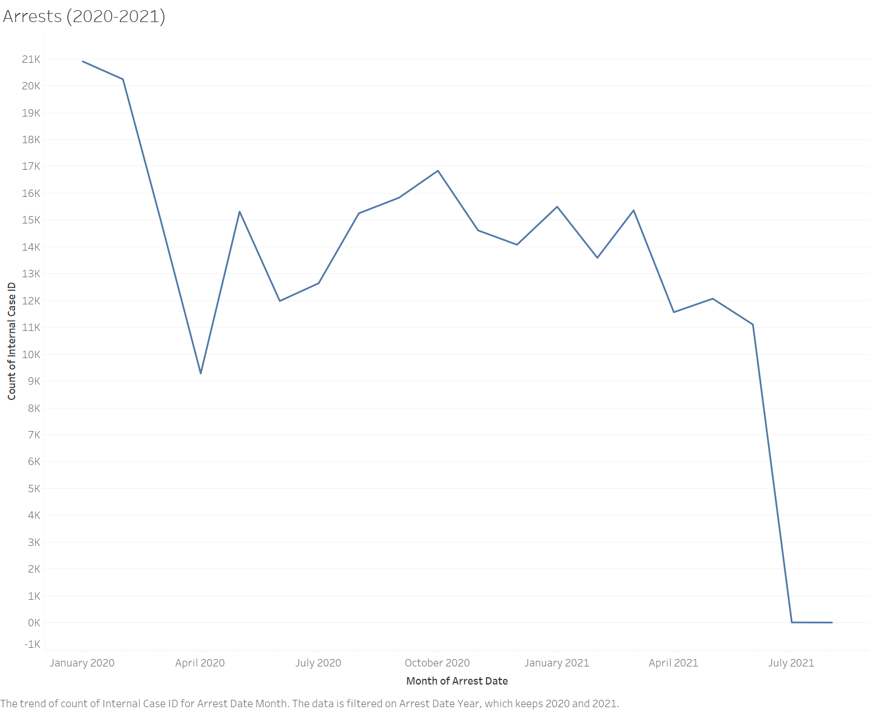
Arrests 2020-2021

Slide 14
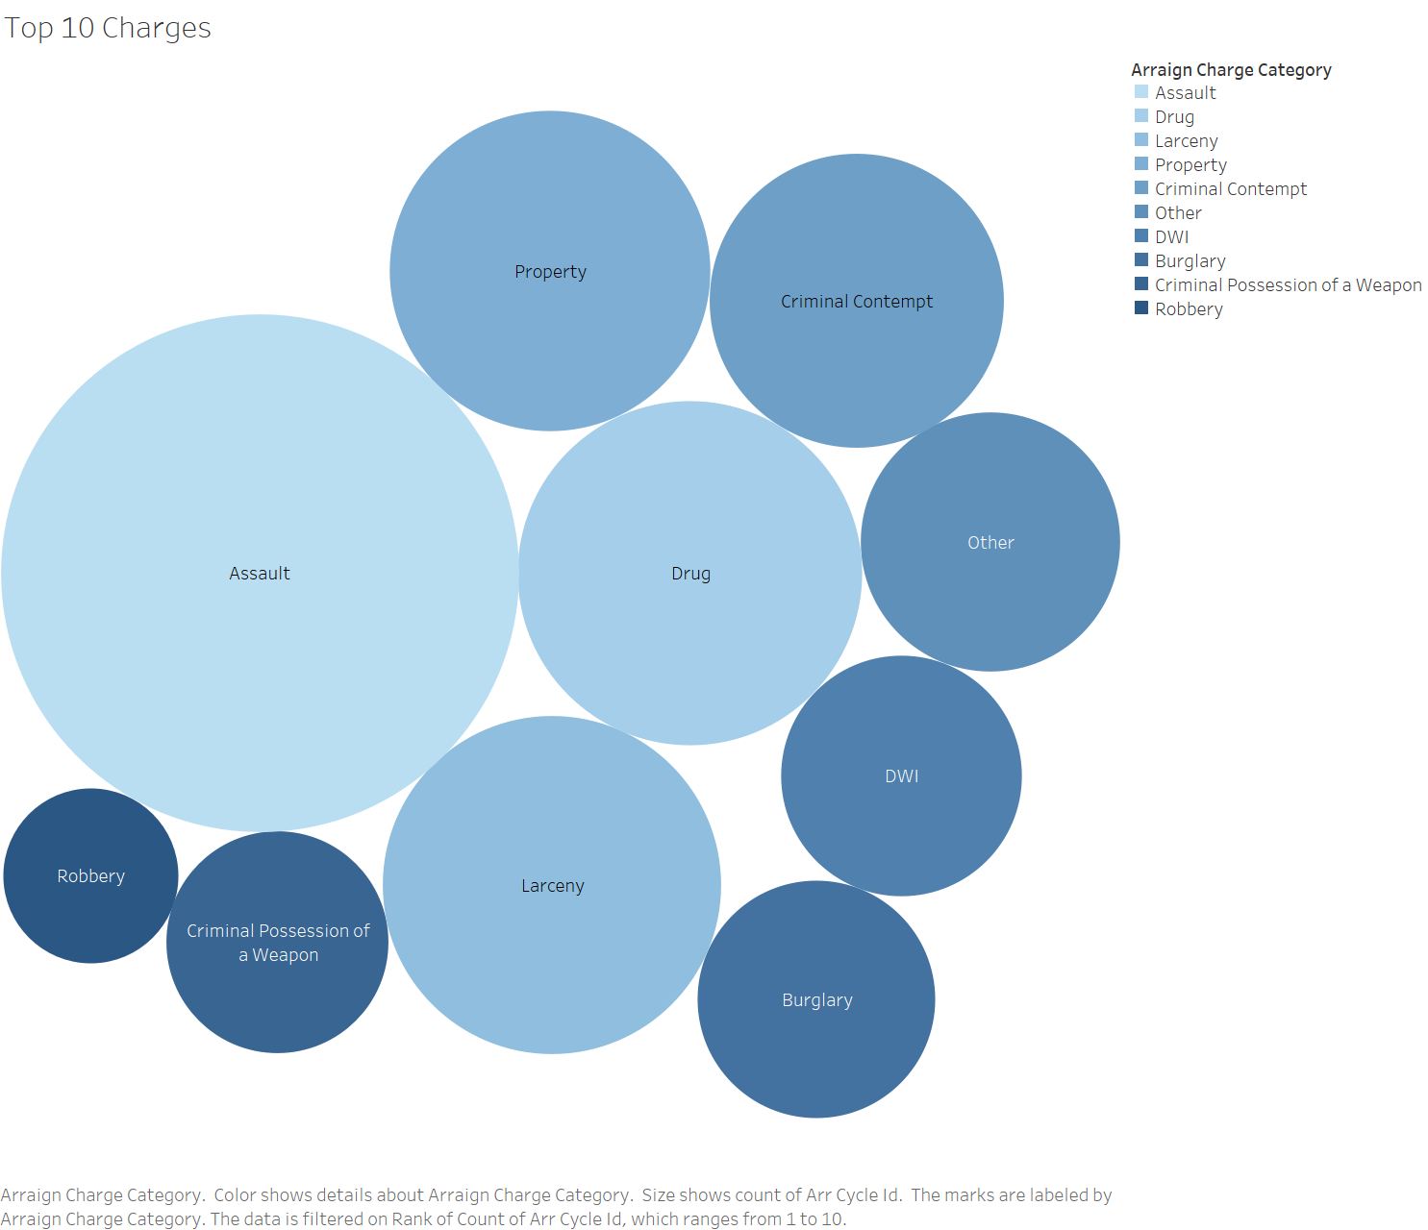

Slide 15
Implementation plan
Can we predict whether bail will be set?
ML models ( decision trees, binary classification)
Can we predict the bail amount?
Predictive Classification models
What factors are the most closely related to the bail decisions being made?
Decision Trees
Do we observe any biases in how bail is determined?
Determined via data visualization and statistical modelling

Slide 16
Sources:
https://www.americanbar.org/groups/public_education/resources/law_related_education_network/how_courts_work/bail/
https://theintercept.com/2020/07/12/risk-assessment-tools-bail-reform/
https://www.wired.com/story/algorithms-supposed-fix-bail-system-they-havent/
https://www.washingtonpost.com/opinions/2022/01/07/court-fees-cash-bail-debtors-prison/

